Slide 1

BudWatch Temperature and Humidity Monitoring System for Cannabis Storage Boxes
Jay Urscheler, Feb 15, 2025
George Brown College Capstone COMP3099
Code and PPT available at https://github.com/jurscheler/BudWatch
Project for Summerleaf Saugeen, Sauble Beach

Slide 2
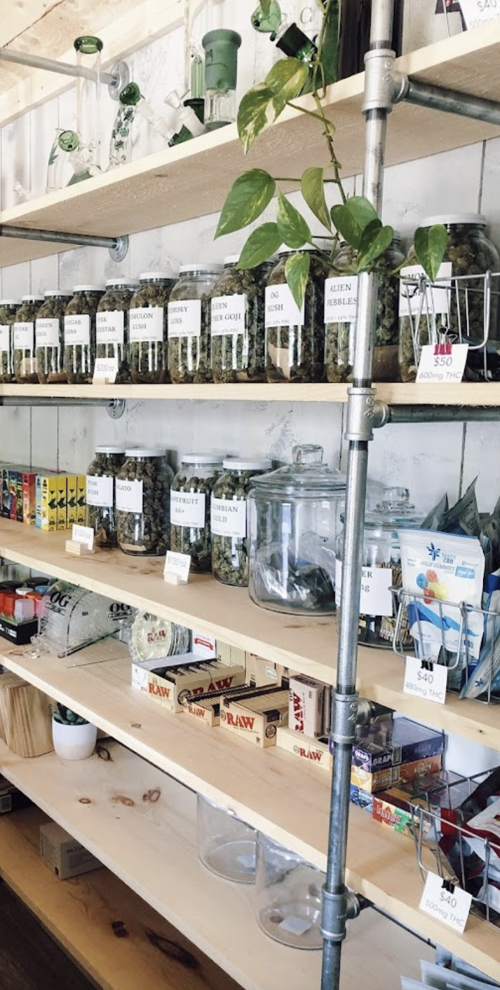
Project Overview
Objective: Develop a system to monitor temperature and humidity in cannabis storage boxes.
Purpose: Ensure optimal storage conditions for Summerleaf Saugeen’s products.
Scope:
Design and build a sensor-based monitoring system.
Collect, store, and visualize data.
Provide a user-friendly solution for the business.

Slide 3
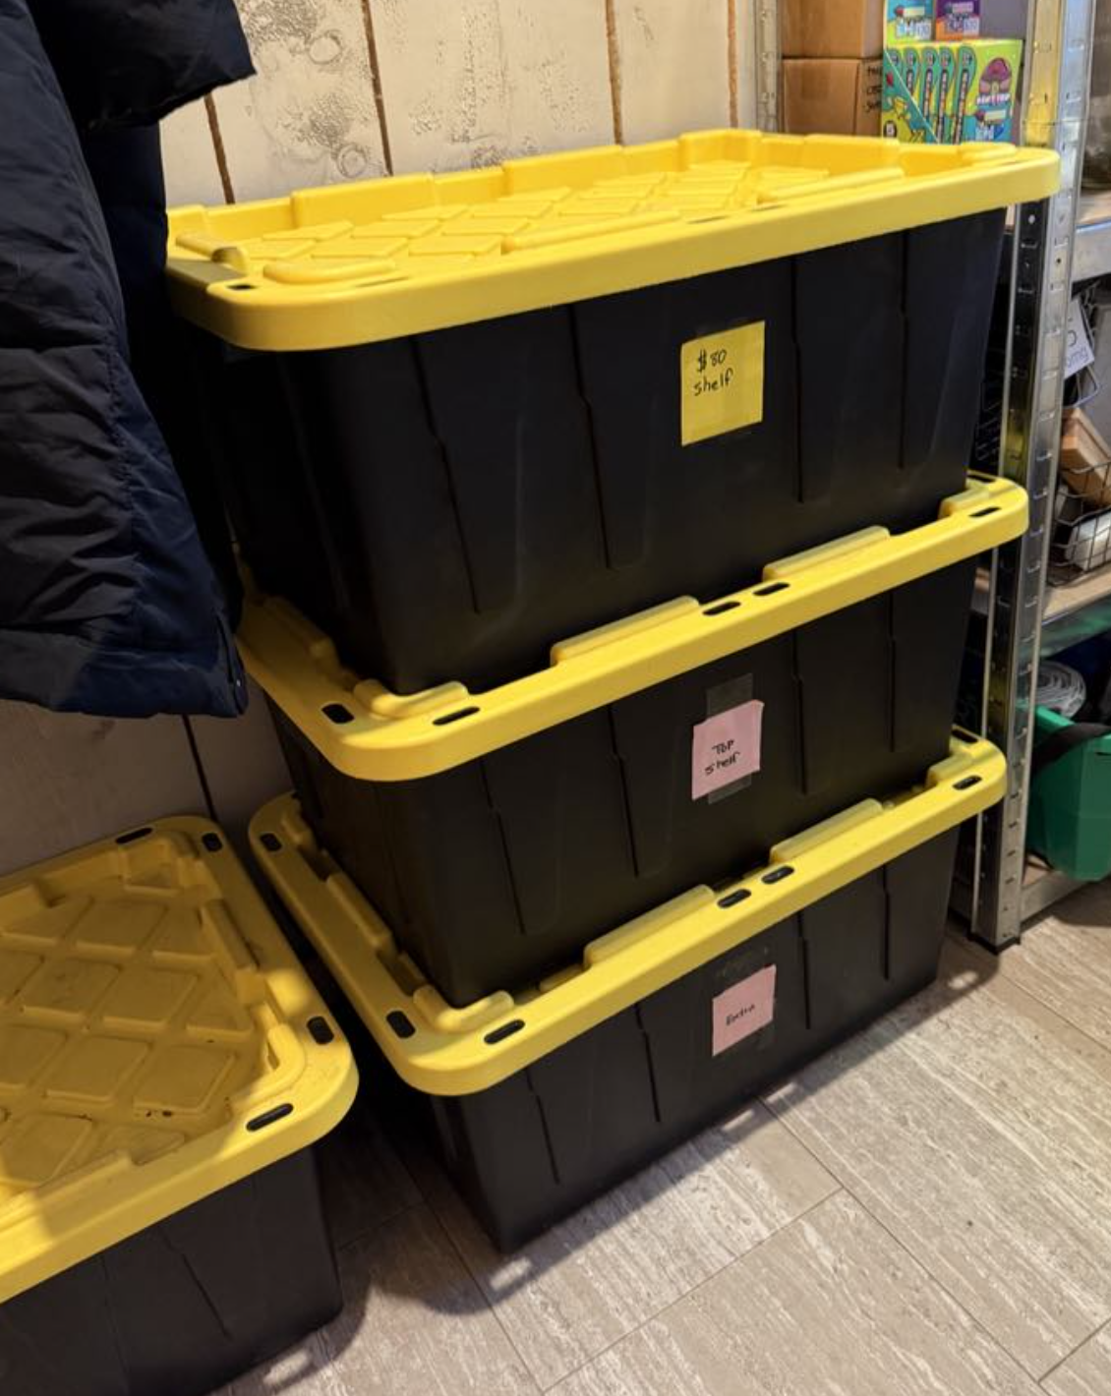
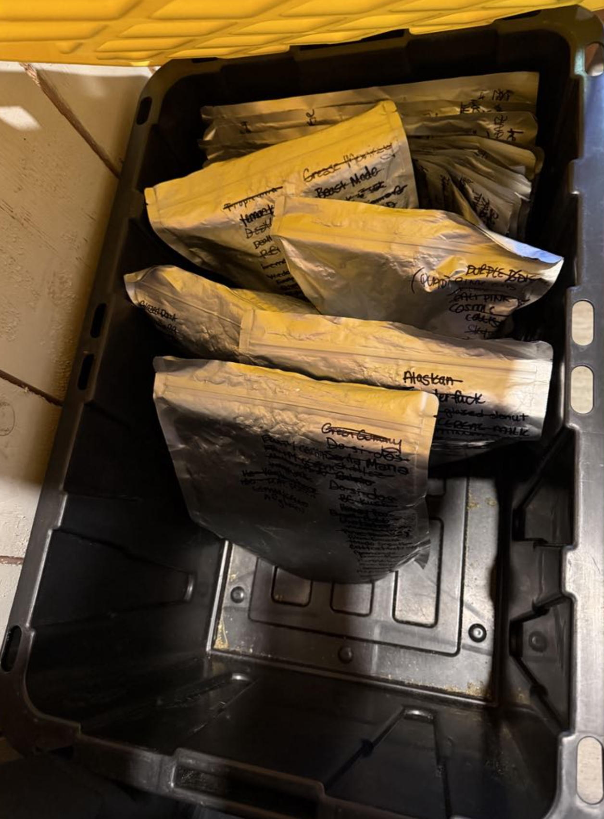
Project background
Local cannabis store (Summerleaf Saugeen) has concerns on humidity in storage room, where cannabis products are stored in storage boxes.
Cannabis products should be stored between 15-21°C and 55-62% humidity.
Store owner would like to be able to monitor the temperature of each storage container and ideally get notified if the temperature or humidity falls outside of the above-mentioned threshold.

Slide 4
Project Plan
Phases:
Research and Requirements Gathering
System Design
Prototyping
Implementation
Data Management and Visualization
Testing and Validation
Deployment and Maintenance

Slide 5
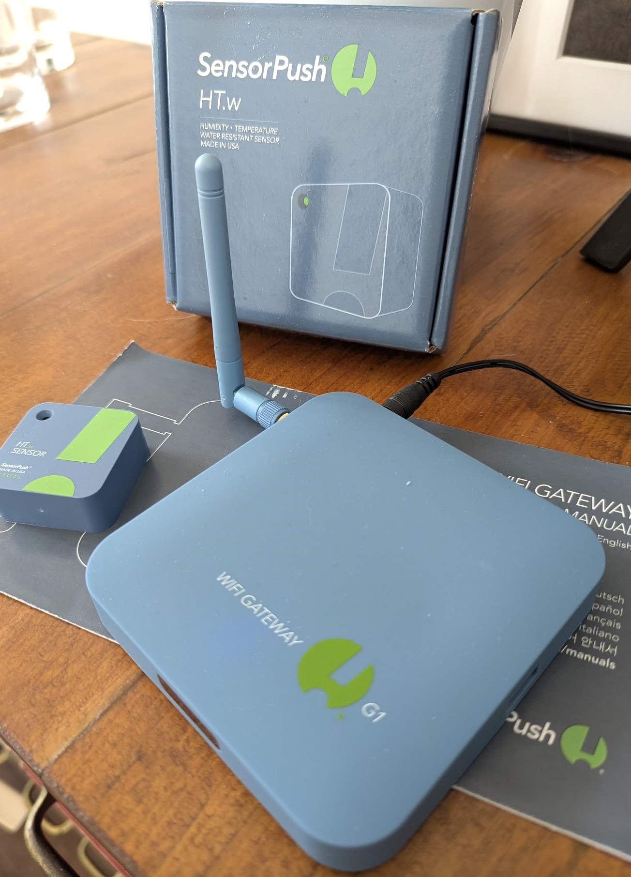
Research and Requirements
Identified business needs from Saugeen Summerleaf
Determine high level solution, i.e.
Raspberry PI / Arduino with wired sensor vs. WIFI enabled sensor
Data storage: Local SD card or cloud-based
Research and select sensor
sensor
gateway

Slide 6
System Design
Hardware Design
Bluetooth sensors placed inside storage boxes
Sensor Gateway placed in room with BT connectivity to sensor and WIFI to cloud
Software Design
Python code to periodically read sensor data via Sensor provide cloud API
Data stored in MS SQL database on local PC
Simple dashboard for visualization

Slide 7

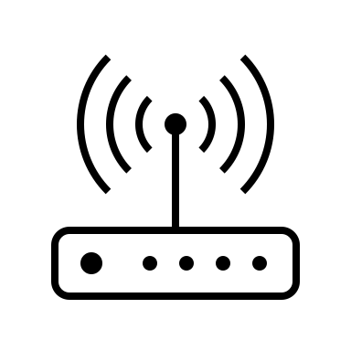
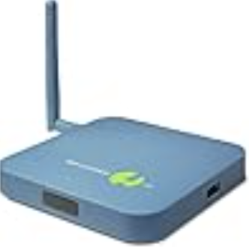
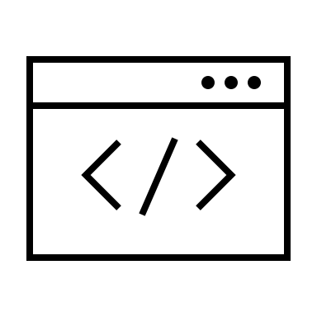

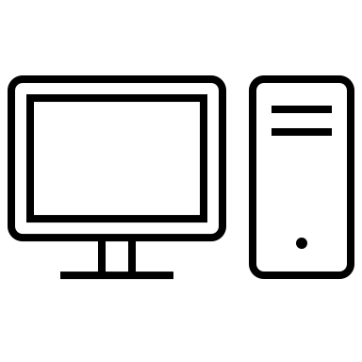
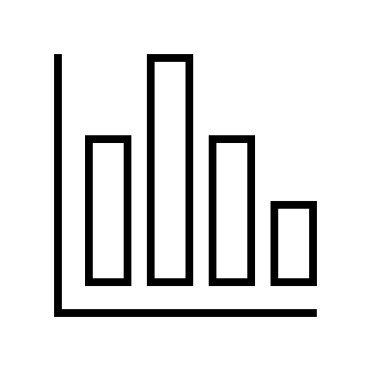
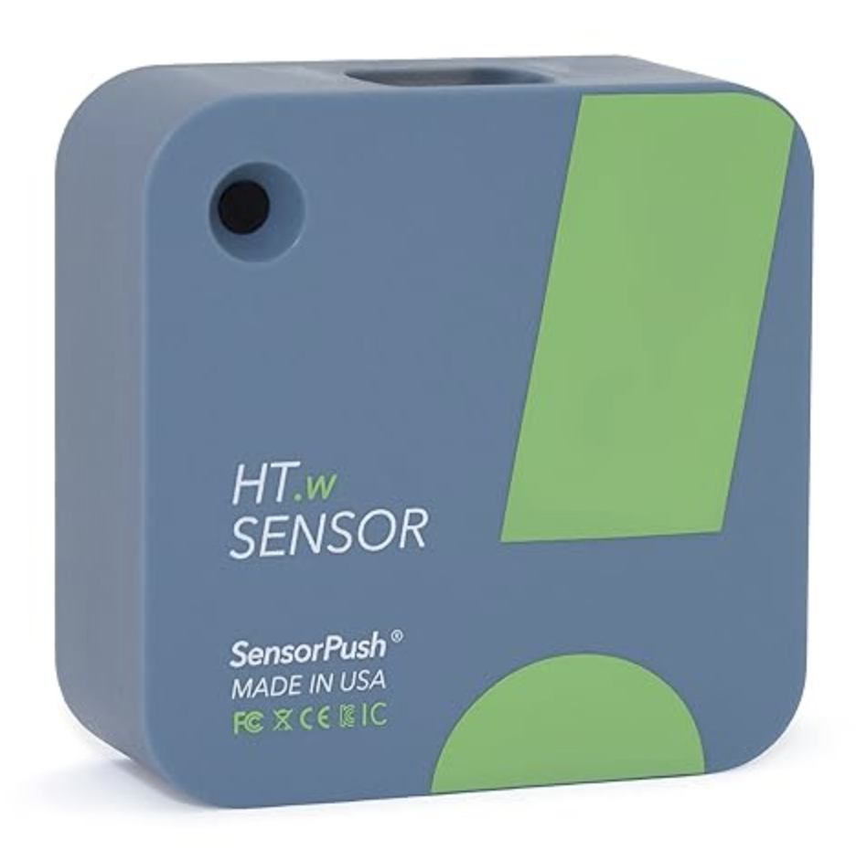
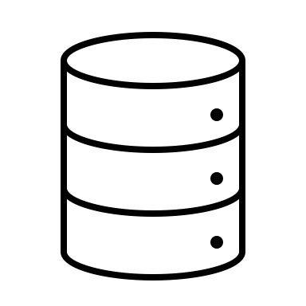
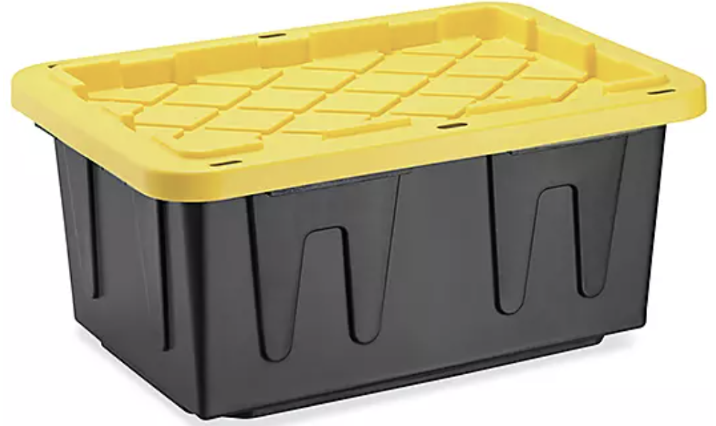
System Design
SensorPush Cloud
HTTP
HTTP
Location: Store
Location: Office
Wifi router
Server
HTTP
Python
Sensor
gateway
Bluetooth
HTTP
Web Server
PC
Database
Storage containers with sensor

Slide 8
Prototyping - Collect Data In first half of semester
Setup and connect SensorPush sensor and gateway
Create SensorPush account for Cloud API usage
Create python program to:
authenticate with SensorPush cloud REST API
fetch sensors linked to account
periodically fetch data from sensor
save fetched temperature and humidity data into local MS SQL Server DB

Slide 9
Prototyping – Visualize Data In second half of semester
Investigate web dashboard solutions
Create simple web application that fetches data from database and visualizes data in a graph
Optional enhancements:
Filter data visualization by sensor, date range etc
Alarm configuration when reaching threshold
Send notification (email) when threshold reached

Slide 10
Implementation
Fix sensor in storage box
Combine prototyping scripts (fetch data script and store to DB script)
Improve Cloud API authentication so not to hardcode passwords
Create and host web application to visualize data

Slide 11
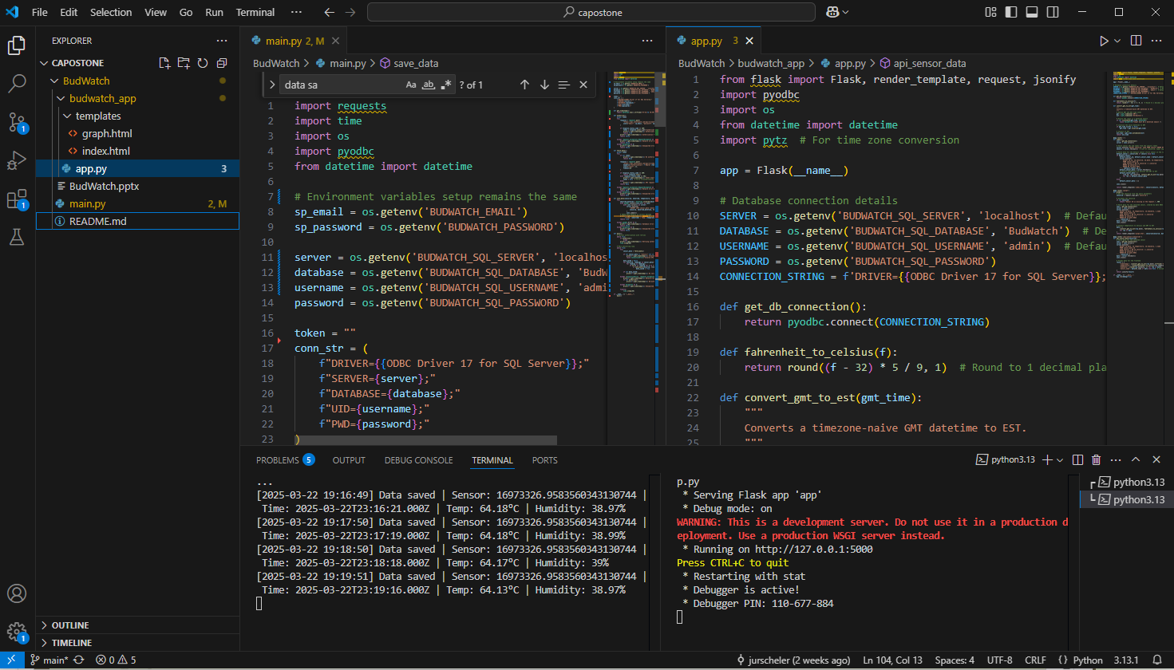
Python service and web app

Slide 12
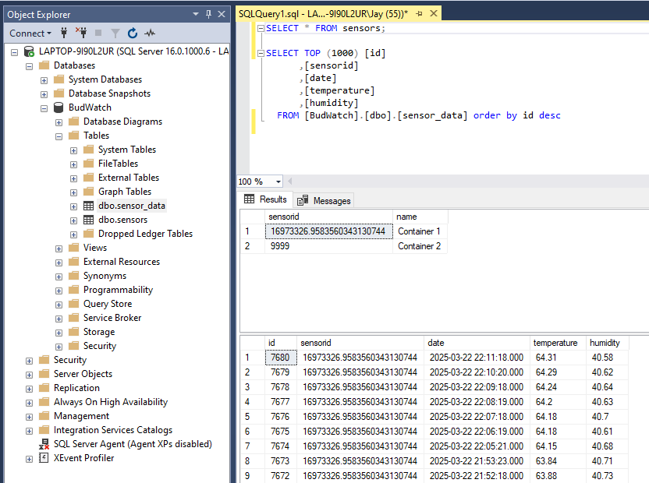
Data storage - SQL Server

Slide 13
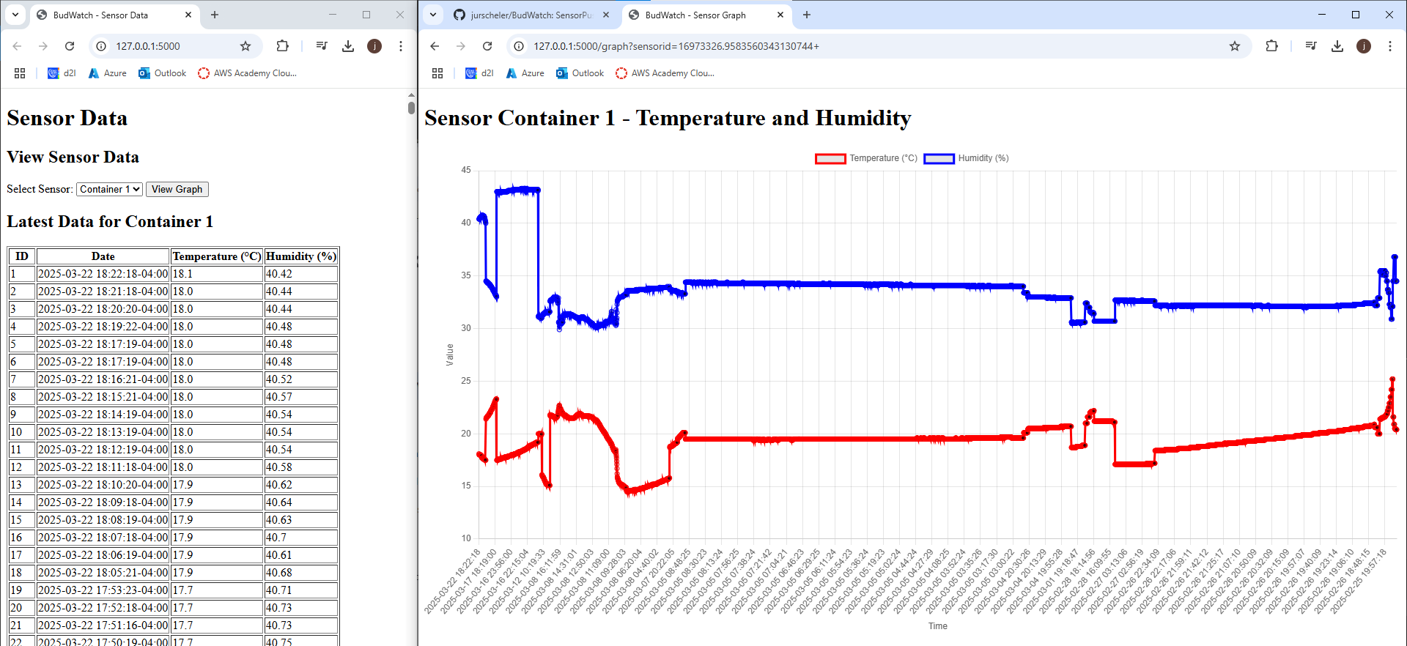
Data visualization
Web Application written in python, hosted with flask and chart using chart.js.

Slide 14
Testing and validation
Purchase additional sensors to test collection and visualization of multiple sensors
Train business manager on how to use the solution
Provide instructions and documentation to business

Slide 15
Deployment and Maintenance
If solution is working good, customer is considering deploying solution in sister store as well.
Setup SQL Server backup and maintenance
No other maintenance should be needed with this solution

Slide 16
Future improvements
Run apps as a windows service with auto start
Add functionality to send email (and/or SMS) when threshold is reached
Run python app fetching sensor data in cloud with cloud database
Run web app in cloud

Slide 17
Conclusion
A lot of time was spent finding a sensor that is not wired and supports wifi, either directly or via a gateway.
Was able to use different aspects of what I learned in the past 3 years such as MS SQL Server, Python programming, Web development, protocols such as HTTP (for REST APIs) and of course Project Management.
Enjoyed working on a real project that will actually be used, rather than just a school project.
Underestimated the effort. Mainly did not consider time spent on unexpected issues.

Slide 18
Questions

